Slide 1
Start For Future (SFF) Program:
LEARN (April – June 2025)
Program Essentials

Slide 2
What is LEARN?
LEARN is a team-based international program for students from all disciplines (Bachelor, Master, PHD), which is dedicated to foster their intercultural and entrepreneurial skills by working within an international setting.
Students’ journey in LEARN is centered around working on real-life problems, creating prototype concepts and exchanging knowledge, all towards improving students’ soft skills, such as oratory, time management, creativity and teamwork.
LEARN runs twice per year, between April - June and October - December.

Slide 3
What to expect?
LEARN consists of 5 sessions. Throughout sessions, students and student teams are going to work on, develop, and at the end, present their project ideas, which they either brought into the program or developed during their participation in LEARN . Important here is that these project ideas need to be reflective and connected with one of SFF verticals / Topics (Urban Mobility, Healthcare, Manufacturing, Food, Energy and Circular Economy), tackling potential customer or societal problems within the chosen vertical and offering innovative solution to it.

Slide 4
How Does The LEARN Work?
Across Five LEARN sessions, students train their ability of setting up some core parts of business model, capturing elements of problem-solution fit, target customer selection, USP, competition analysis, product/service pricing and shopping channels.
At the 1st session, students meet with industry professionals (Input Speakers) who provide input about modern trends and best practices within SFF topics, helping student teams to form a project idea on which they are going to work during the program or developing an already existing ones.
The 2nd & 4th sessions are dedicated to personalized coaching, where teams pitch, refine and develop their projects further by incorporating feedbacks from SFF startup coaches and their international peers.
The 3rd session facilitates deepening students’ interest towards entrepreneurship and Startup world by discussions between teams and SFF Alumni startups who disclose own stories about their business.
The 5th session is the culmination of LEARN, where student teams pitch and demonstrate their learnings from the program.
4

Slide 5
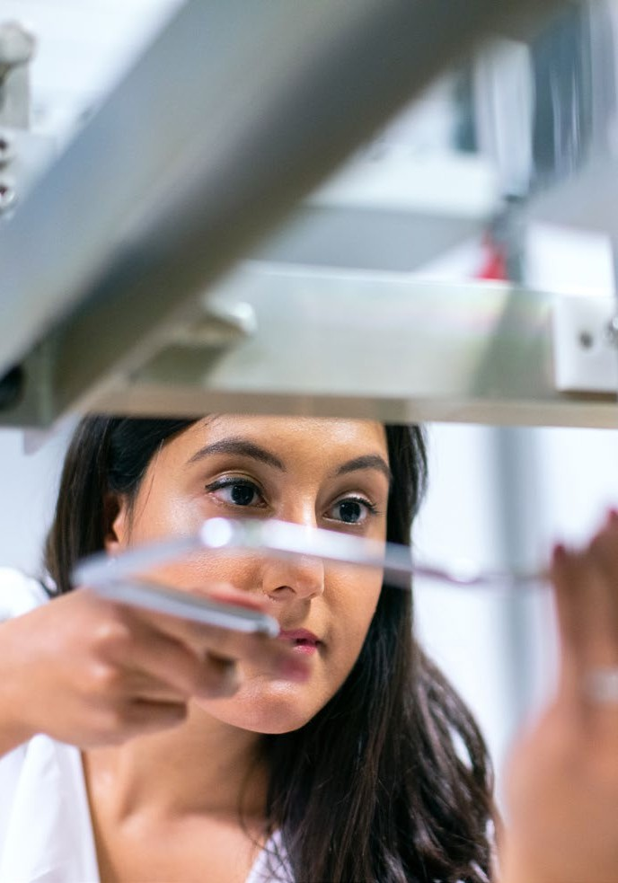
Why and How to take part in the project – LEARN (Students – Bachelor, Master, PHD)
STUDENT BENEFITS
1
Gain intercultural & entrepreneurial skills and SFF certificate of completion.
2
Grow your professional network.
3
Work in an international setting with similar project teams across Europe and beyond.
4
Mentorship with your project after the course in one of the European incubators.
5
Chance to win some prizes.
HOW TO GET & PROCEED IN LEARN
1
Read through decks & brochure of what expects you in LEARN.
2
Apply for LEARN through Application Link by the end of the application deadline.
Only one representative of the team should fill in the online application form
3
Attend all 5 LEARN sessions. Use the SFF platform for information exchange.
4
Be ready to have some entrepreneurial fun with SFF and meet an interesting people.

Slide 6
LEARN Timeline: April – June 2025
INPUT SPEAKER
COACH
STARTUP
COACH
1
Monday 07.04.2025
2
Monday 14.04.2025
3
Monday 28.04.2025
Monday 12.05.2025
5
Monday 02.06.2025
4
Action Field Discovery
Project roadmap, peer reviews & feedback
Startup Stories from SFF Ecosystem
Business Model Review with coaches & peers
Final Pitches
Session Agenda in upcoming Slides
Session Agenda in upcoming Slides
Session Agenda in upcoming Slides
Session Agenda in upcoming Slides
Session Agenda in upcoming Slides
1,5 hours session
16-17:30 CET
1 hour & 15 min session
16-17:15 CET
1 hour & 15 min session
16-17:15 CET
1 hour & 15 min session
16-17:15 CET
2 hours session
16:00 -18:00 CET

Slide 7
Who & How can apply?
Regardless of Education background, a single student (Solo team) and student teams (2 – 6 members) from any academic discipline are welcomed and can participate in LEARN. The main criteria is to have a wish and motivation to develop a project concept, solving specific challenges within one of SFF Verticals / Topics.
Applicants need to apply via the online application form during the application period. Only ONE team member has to apply on behalf of own team. In the application form, applicants will be asked about a team name and a SFF Vertical, wherein a team is interested to develop own project. After application, changing the team’s name and/or chosen SFF vertical is not allowed.
After application deadline (31 March), all team members will get the SFF platform invitation link. Each one needs to open the link, register and activate own profile on SFF platform before the 1st Kick Off Session.

Slide 8
Application Know-How
The Core Points for Student Applications
Application Period:
21 January – 31 March, 2025
Application link:
https://scefreiraum.typeform.com/to/UGuq6WCx
For more information, visit our platform: startforfuture.eu
Follow us on Linkedin: https://www.linkedin.com/company/start-for-future/
Instagram:
https://www.instagram.com/startforfuture_official/
Read the brochure to be familiar with the program details
Only ONE team member has to apply on behalf of own team
At least 1 team member needs to attend all 5 sessions
After application deadline, all team members will get the SFF platform invitation link and each of them must register before the 1st Kick Off Session.
Know that changing the team’s name and chosen SFF vertical, wherein a team attempts to develop a project, is not allowed after application.
8

Slide 9
Thank you for your time & attention.
For more questions, contact:
Giorgi Japaridze
Strascheg Center for Entrepreneurship (SCE)
Giorgi.japaridze@sce.de

